Slide 1
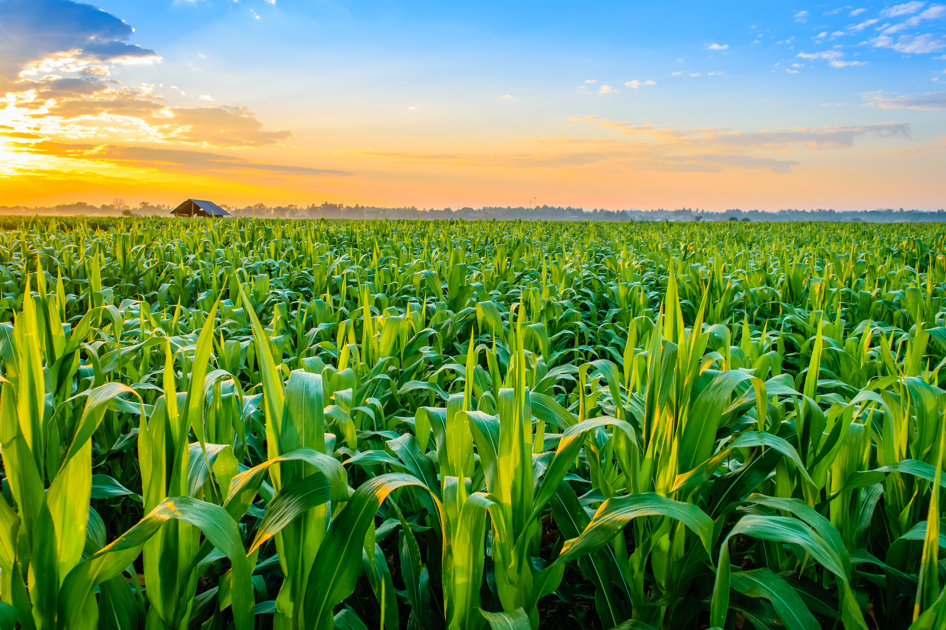
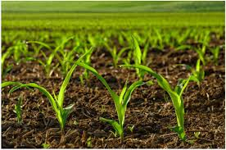
CROP RECOMMENDATION SYSTEM
TEAM MEMBERS:
SIDDHARTH RAJ
AVNEESH PANWAR
ASHIRWAD SINGH UJJAIN
HARSHIT PANDEY

Slide 2
INTRODUCTION
The Crop Recommendation System is a Python Django based machine learning project that utilizes the Random Forest Classifier algorithm to provide accurate crop recommendations to farmers based on soil and environmental Conditions. It consists of user and admin modules, allowing users to receive recommendations ,view and prediction History, and manage their profiles, while administrator can access analytics and manage users. The system uses parameters Like nitrogen, phosphorus, potassium levels, temperature , humidity, pH, rainfall to determine suitable crops. Its goals is to help farmers make informed decisions and maximize agricultural productivity.
In this system farmers can detect which crop is suitable for farming according to cities which helps them in crop production .Users can also view the information about the crop through view info. Button beside crops recommended.

Slide 3
OBJECTIVE
The Crop Recommendation System using random forest Classifier aims to achieve accurate crop selection , enhance crop yields, promote sustainable farming practices, serve as a decision support tool, provide a user friendly interface and ensure scalability and adaptability. By leveraging historical data and advanced algorithm , the system provides precise recommendations based on soil and environmental parameters helping farmers make informed decisions for improved productivity and sustainability.

Slide 4
NEED OF THE SYSTEM
The need for the Crop Recommendation System using Random forest Classifier arises from the challenges faced by farmers in making informed decisions `about crop selection .Traditional method often lack accuracy and fail to consider various factors affecting crop productivity. By leveraging Machine Learning techniques ,the system provides precise and data driven Recommendations based on factors such as soil composition, temperature , humidity, pH level and rainfall. This helps farmers optimize resource allocation ,improve crop yield, minimize environmental impact and make informed decisions for sustainable agricultural practises. The system serves as a valuable tool to enhance productivity , profitability, and sustainability in the agricultural sector.

Slide 5
PROPOSED SYSTEM
The proposed Crop Recommendation System using Random Forest Classifier aims to overcome limitations by utilizing machine learning algorithms to provide accurate and personalized crop recommendations . It analyse data such as soil nutrients , temperature , humidity , pH , rainfall to train a Random forest classifier model . Users can access the system through a user friendly web interface ,input their parameters and received customized crop recommendations . The system also includes a prediction history feature for monitoring performance . The objective is to enhance crop productivity , resource efficiency and promote sustainable farming practices.

Slide 6
USER MODULES
Signup: Users can create a new account by providing their personal details , such as name ,email and password.
Login : Registered users can log in to the system using their credentials to access personalized features .
Crop Recommendation Prediction: Users can input various parameters such as nitrogen , phosphorus, potassium levels in the soil , temperature , humidity , pH value , and rainfall to get crop recommendations based on the Random forest Classifier algorithm.
View prediction history :Users can view their past crop recommendation prediction, including the recommended crops and relevant details.
View Info. : Users can view the information of the recommended crop .
Edit profile : Users have the option to update their profile information , such as name , contact details or any other relevant details.
Change Password : Users can change their account password to enhance security.
Logout: Users can log out of the system to end their session securely.

Slide 7
ADMIN MODULES
Login: The admin will have a login functionality to access the admin dashboard and perform administrative tasks.
Dashboard: The admin will have a dashboard that provides an overview of important information such as user counts , recommendation prediction results count , and other relevant statistics.
View Prediction history: The admin will be able to view the prediction history, which includes the crop recommendations made for
Different users over time .
View Registered Users: The admin can view the list of registered users in the system , including their details such as name, contact details,
And other relevant details.
Change Password: The Admin will have the ability to change their password for security purposes.
Logout: The admin can log out of the admin panel to ensure secure access to the system.

Slide 8
SOFTWARE AND TECHNOLOGIES USED
FRONTENED TECHNOLOGIES(HTML , CSS , BOOTSTRAP, JAVASCRIPT
PYTHON INTERPRETOR
PYCHARM IDE
DJANGO FRAMEWORK
MACHINE LEARNING
CHROME OR ANY OTHER BROWSER

Slide 9
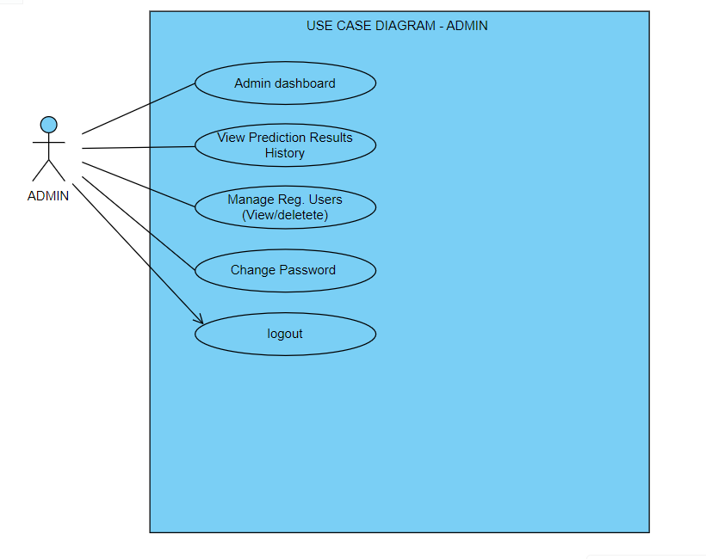

Slide 10
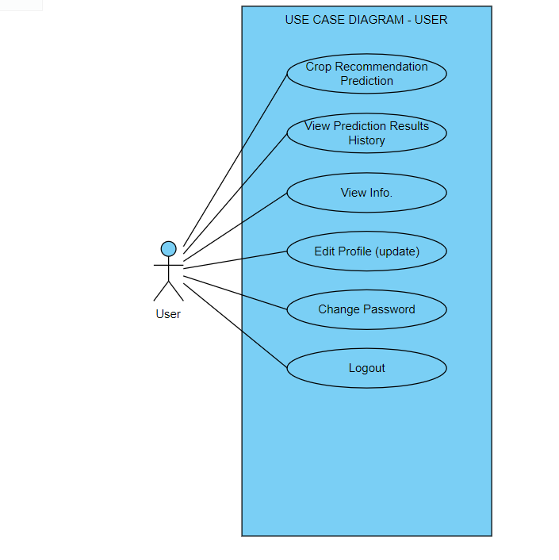

Slide 11
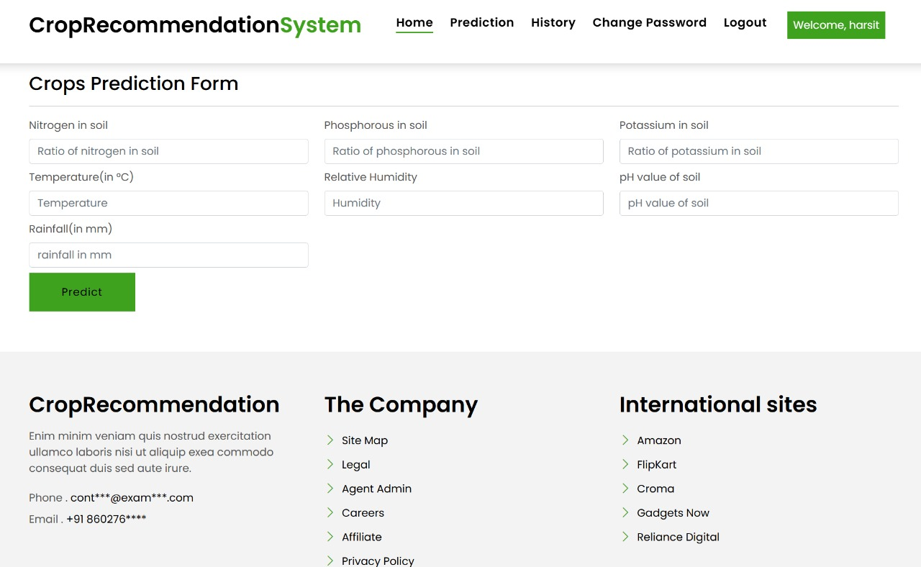

Slide 12
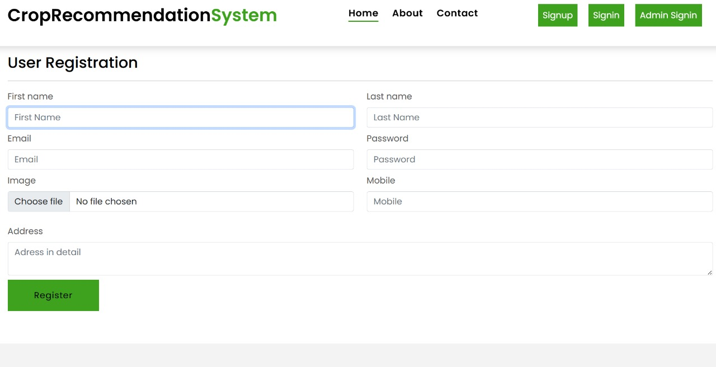

Slide 13
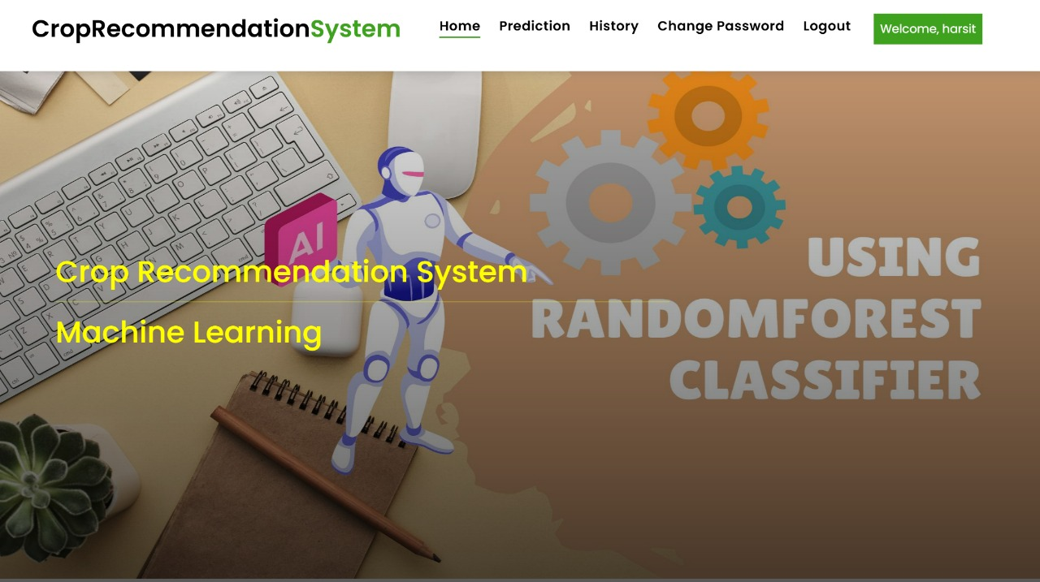

Slide 14
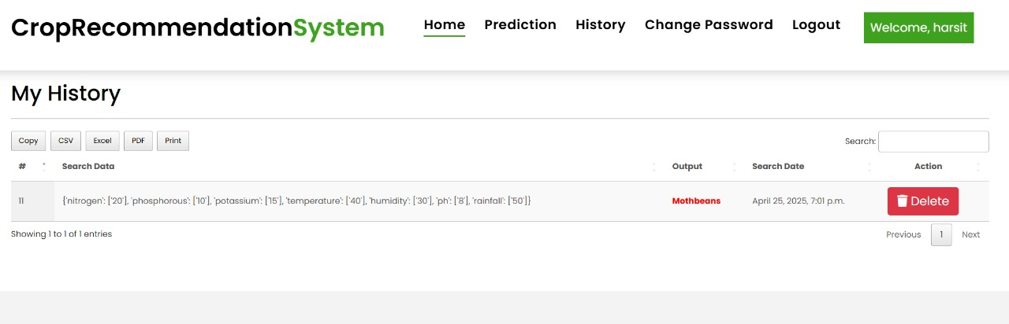

Slide 15
CONCLUSION
In conclusion , the Crop Recommendation System using Random Forest Classifier offers an efficient and effective solution for assisting farmers in making informed decisions about crop selection. By leveraging machine learning algorithms and historical data , the system provides personalized crop recommendations based on various soil and environmental factors . It simplifies the decision making process , enhances productivity and optimizes resource utilization. The system’s user friendly interface and easily accessibility make it a valuable tool for farmers , enabling them to improve their agricultural practices and achieve better crop yields . As technology advances and more data becomes available , there is a great potential for further enhancing the accuracy and performance of crop recommendation systems , ultimately contributing to sustainable farming practices and agricultural growth.

Slide 16
FUTURE SCOPE
The Future scope of Crop recommendation system using Random forest Classifier includes improving accuracy through advanced algorithm and technologies , personalisation recommendation based on individual preferences and farm Conditions , integrating climate changes adaptation strategies , developing mobile applications for enhanced accessibility , fostering knowledge sharing and collaboration , expanding to different to different regions and crops , and incorporating decisions support tools. These advancement aims to optimise agricultural practices and increase productivity and addresses emerging challenges in the agricultural sector.

Slide 17


